Slide 1
Operating Systems
计算机科学与技术学院
高海昌
hchgao@xidian.edu.cn

Slide 2
Major Content & Grade
  1. Introduction **
  2. Processes and Threads ******
  3. Deadlocks **
  4. Memory Management *****
  5. Input/Output ***
  6. File Systems ****
  8. Multiple Processor Systems **
  9. Security **
  10. Case study – Linux *

Slide 3
Processes and Threads
  2.1 Processes （进程）
  2.2 Threads（线程）
  2.3 Scheduling（调度）
  2.4 Interprocess communication（进程间通信）
  2.5 Classical IPC problems （经典IPC问题）

Slide 4

Processes: The Process Model
Process: an executing program, including the current values of the program counter, register, and variables.
Multiprogramming of 4 programs
Conceptual model of 4 independent, sequential processes
Only one program active at any instant

Slide 5
Process Concept
An operating system executes a variety of programs:
  Batch system – jobs
  Time-shared systems – user programs or tasks
Textbook uses the terms job and process almost interchangeably.
Process execution must progress in sequential fashion.
A process includes:
  program counter 程序计数器
  stack 栈
  data section 数据部分

Slide 6
Process Creation
Principal events that cause process creation:
System initialization （系统初始化）
Execution of a process creation system （系统调用）
User request to create a new process（用户命令）
Initiation of a batch job（批处理作业的初始化）

Slide 7
Process Creation (2)
Parent process creates children processes, which, in turn create other processes, forming a tree of processes.
Resource sharing
  Parent and children share all resources.
  Children share subset of parent’s resources.
  Parent and child share no resources.
Execution 执行
  Parent and children execute concurrently.
  Parent waits until children terminate.

Slide 8
Process Creation (3)
Address space
  Child duplicate of parent. 子女复制双亲
  Child has a program loaded into it. 子女有一个程序被调入
UNIX examples
  fork system call creates new process
  execve system call used after a fork to replace the process’ memory space with a new program.
  在fork 用一个新程序替代了进程的内存空间之后，采用execve系统调用

Slide 9
Process Termination
Conditions which terminate processes:
Normal exit (voluntary)
Error exit (voluntary) （错误退出）
Fatal error (involuntary) （严重错误）
Killed by another process (involuntary)

Slide 10
Process Termination (2)
Process executes last statement and asks the operating system to decide it (exit).
  Process’ resources are deallocated (再分配) by operating system.
Parent may terminate execution of children processes (abort).
  Child has exceeded allocated resources. 超量分配资源
  Task assigned to child is no longer required.
  Parent is exiting.
    Operating system does not allow child to continue if its parent terminates.
    Cascading termination. 级联终止

Slide 11
Process Hierarchies
Parent creates a child process, child processes can create its own process, forms a hierarchy （层次关系）
  UNIX calls this a “process group”
Windows has no concept of process hierarchy
  all processes are created equal

Slide 12

A Tree of Processes On A Typical UNIX System

Slide 13
Process State
As a process executes, it changes state
  new: The process is being created.
  running: Instructions are being executed.
  waiting (blocked): The process is waiting for some event to occur.
  ready: The process is waiting to be assigned to a processor.
  terminated: The process has finished execution.

Slide 14

Diagram of Process State

Slide 15
When to Switch a Process
Clock interrupt
  process has executed for the maximum allowable time slice
I/O interrupt
Memory fault
  memory address is in virtual memory so it must be brought into main memory
Trap
  error occurred
  may cause process to be moved to Exit state
Supervisor call 管理程序调用
  such as file open

Slide 16

CPU Switch From Process to Process

Slide 17
Context Switch 上下文切换
When CPU switches to another process, the system must save the state of the old process and load the saved state for the new process.
Context represented in PCB of a process,include
-CPU registers
-process state
-memory-management information
Context-switch time is overhead (额外负担); the system does no useful work while switching.
Time dependent on hardware support.

Slide 18
Process Scheduling Queues
进程调度队列
Job queue – set of all processes in the system.
Ready queue – set of all processes residing in main memory, ready and waiting to execute.
Device queues – set of processes waiting for an I/O device.
Process migration between the various queues.

Slide 19
Implementation of Processes
To implement the process model, the operating system maintains a table, called the process table (process control blocks, PCB).
This entry contains information about the process’ state, its program counter, stack pointer, memory allocation, the status of its open files, its accounting and scheduling information, and everything else about the process that must be saved when the process is switched from running to ready or blocked state so that it can be restarted later as if it had never been stopped.

Slide 20
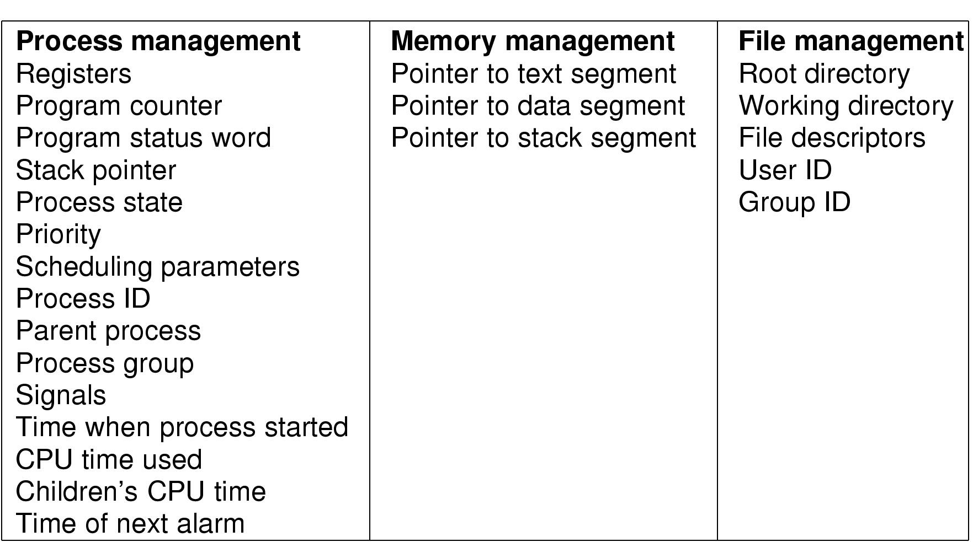
Implementation of Processes (2)
Fields of a process table entry

Slide 21
Process Control Block (PCB)
Information associated with each process.
Process state 进程状态
Program counter 程序计数器
CPU registers CPU寄存器
CPU scheduling information CPU调度信息
Memory-management information 内存管理信息
Accounting information 计账信息
I/O status information I/O状态信息

Slide 22
Processes and Threads
  2.1 Processes （进程）
  2.2 Threads（线程）
  2.3 Scheduling（调度）
  2.4 Interprocess communication（进程间通信）
  2.5 Classical IPC problems （经典IPC问题）

Slide 23
Threads
A thread (or lightweight process) is a basic unit of CPU utilization; it consists of:
线程（轻量级进程）
  program counter, keeps track of which instruction to execute next.
  register set, hold its current working variables.
  stack space, contains the execution history.
A thread shares with its peer threads:
  code section
  data section
  operating-system resources
  collectively know as a task.
A traditional or heavyweight process is equal to a task with one thread

Slide 24

Threads: The Thread Model
(a) Three processes each with one thread, each of them operates in a different address space.
(b) One process with three threads, all three of them share the same address space.

Slide 25
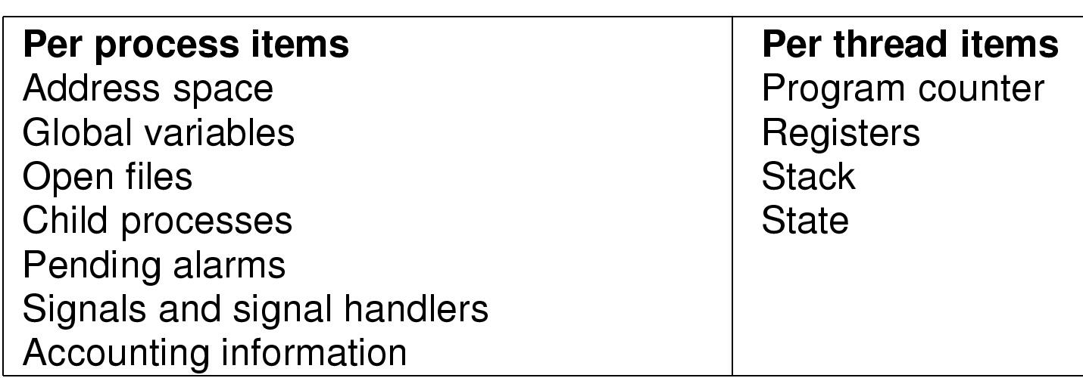
The Thread Model (2)
Items shared by all threads in a process
Items private to each thread

Slide 26

The Thread Model (3)
Each thread has its own stack

Slide 27
The Thread Model (4)
When a multithreaded process is run on a single-CPU system, the threads take turns running.
All threads have exactly the same address space, which means that they also share the same global variables.
Since every thread can access every memory address within the process’ address space, one thread can read, write, or even completely wipe out another thread’s stack. There is no protection between threads.
A thread can be in any one of several states: running, blocked, ready, or terminated.
thread_create; thread_exit; thread_wait; thread_yield.

Slide 28
Thread Usage
Thread has the ability for the parallel entities to share an address space and all of its data among themselves.
It’s easier to create and destroy thread than process since they do not have any resources attached to them.
When there is substantial (大量的) computing and also substantial I/O, having threads allows these activities to overlap, thus speeding up the application.
Threads are useful on systems with multiple CPUs, where real parallelism is possible.

Slide 29
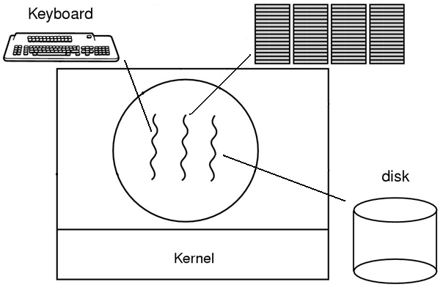
Thread Usage (2)
A word processor with three threads.
Having three separate processes would not work here.

Slide 30

Thread Usage (3)
A multithreaded Web server

Slide 31
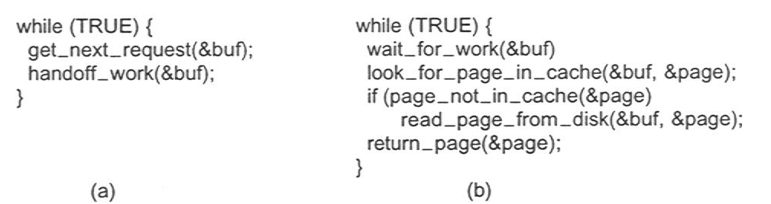
Thread Usage (4)
Rough outline of code for previous slide
  (a) Dispatcher thread (b) Worker thread

Slide 32
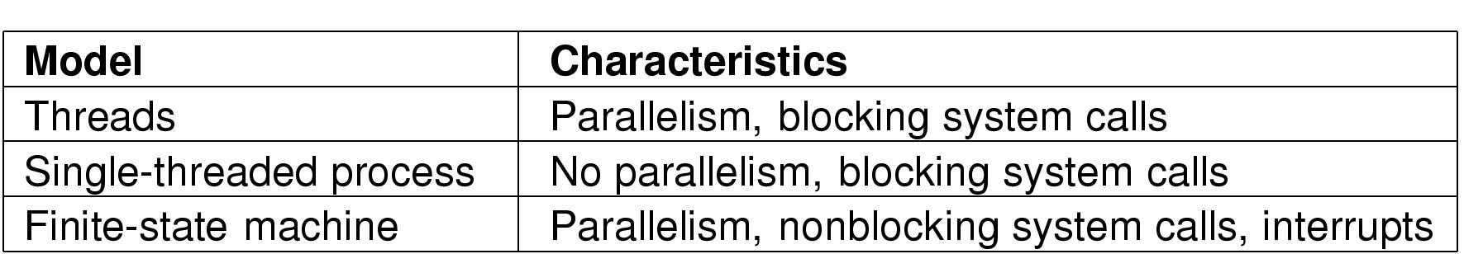
Thread Usage (5)
Three ways to construct a server
FSM: The state of the computation must be explicitly saved and restored in the table every time the server switches from working on one request to another.
A design like this in which each computation has a saved state and there exists some set of events that can occur to change the state is called a FSM.

Slide 33
Implementing Threads
In a multiple threaded task, while one server thread is blocked and waiting, a second thread in the same task can run.
  Cooperation of multiple threads in same job confers higher throughput and improved performance.
  Applications that require sharing a common buffer (i.e., producer-consumer) benefit from thread utilization.
Threads provide a mechanism that allows sequential processes to make blocking system calls while also achieving parallelism.
允许序列进程阻塞系统调用同时还能实现并行
  Kernel-supported threads
  User-level threads; supported above the kernel, via a set of library calls at the user level
  Hybrid approach implements both user-level and kernel-supported threads

Slide 34
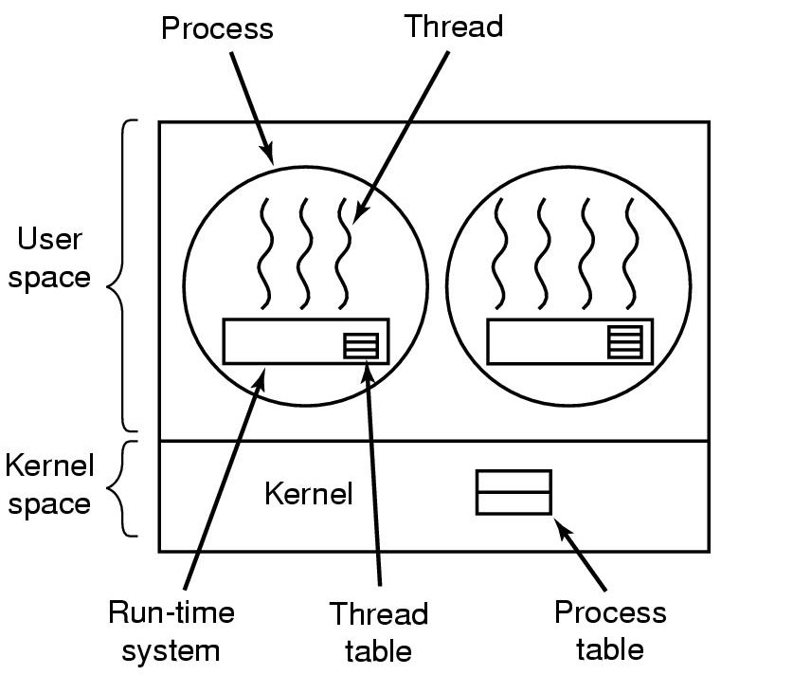
Implementing Threads in User Space
A user-level threads package
As far as the kernel is concerned, it is managing ordinary, single-threaded processes.

Slide 35
Implementing Threads in User Space (2)
Advantage
A user-level threads package can be implemented on an operating system that does not support threads.
  When threads are managed in user space, each process needs its own private thread table. It keeps track the per-thread properties (program counter, stack pointer, registers, state etc).
  The procedure that saves the thread’s state and the scheduler are just local procedures, so invoking them is much more efficient than making a kernel call.
User-level threads allow each process to have its own customized scheduling algorithm.
User-level threads scale better.
  Since kernel threads invariably require some table space and stack space in the kernel, which can be a problem if there are a very large number of threads.

Slide 36
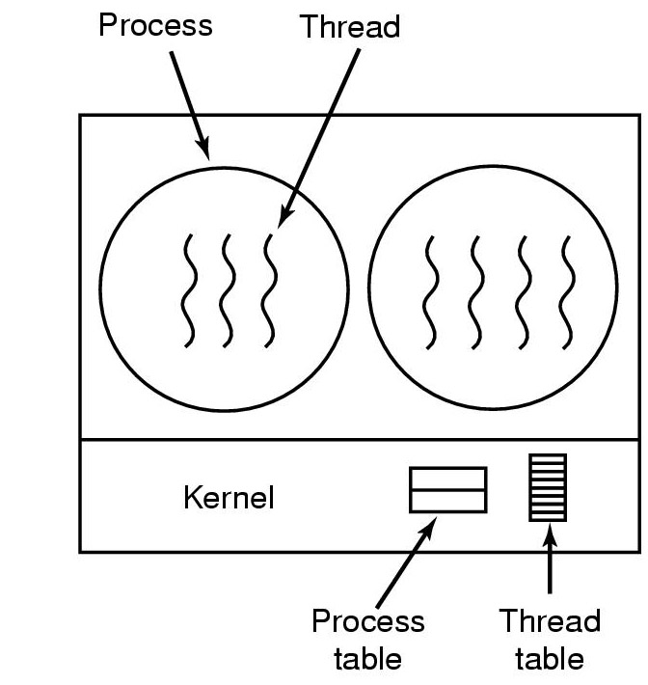
Implementing Threads in the Kernel
A threads package managed by the kernel

Slide 37
Implementing Threads in the Kernel (2)
The kernel has a thread table that keeps track of all the threads in the system.
All calls that might block a thread are implemented as system calls.
When a thread blocks, the kernel can run either another thread from the same process, or a thread form a different process.
Kernel threads do not require any new, nonblocking system calls.

Slide 38
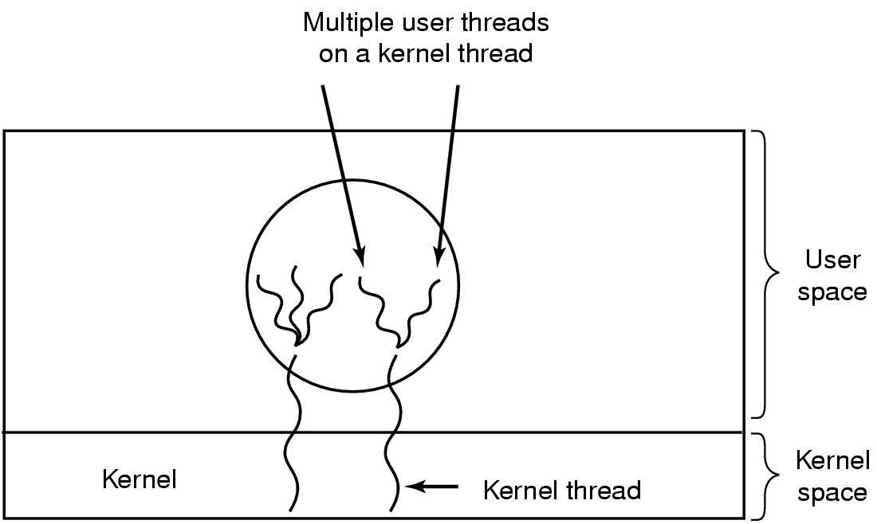
Hybrid Implementations
Multiplexing user-level threads onto kernel- level threads
  The kernel is aware of only the kernel-level threads and schedules those.
  Some of those threads may have multiple user procedure that saves the thread’s state and the scheduler are just local procedures-level threads multiplexed on top of them.
  These user-level threads are created, destroyed, and scheduled just like user-level threads in process.

Slide 39
Scheduler Activations
Goal – Combine the advantage of user threads with the advantage of kernel threads
  mimic (模仿) functionality of kernel threads
  gain performance of user space threads
Avoids unnecessary user/kernel transitions
Kernel assigns virtual processors to each process
  lets runtime system allocate threads to processors

Slide 40
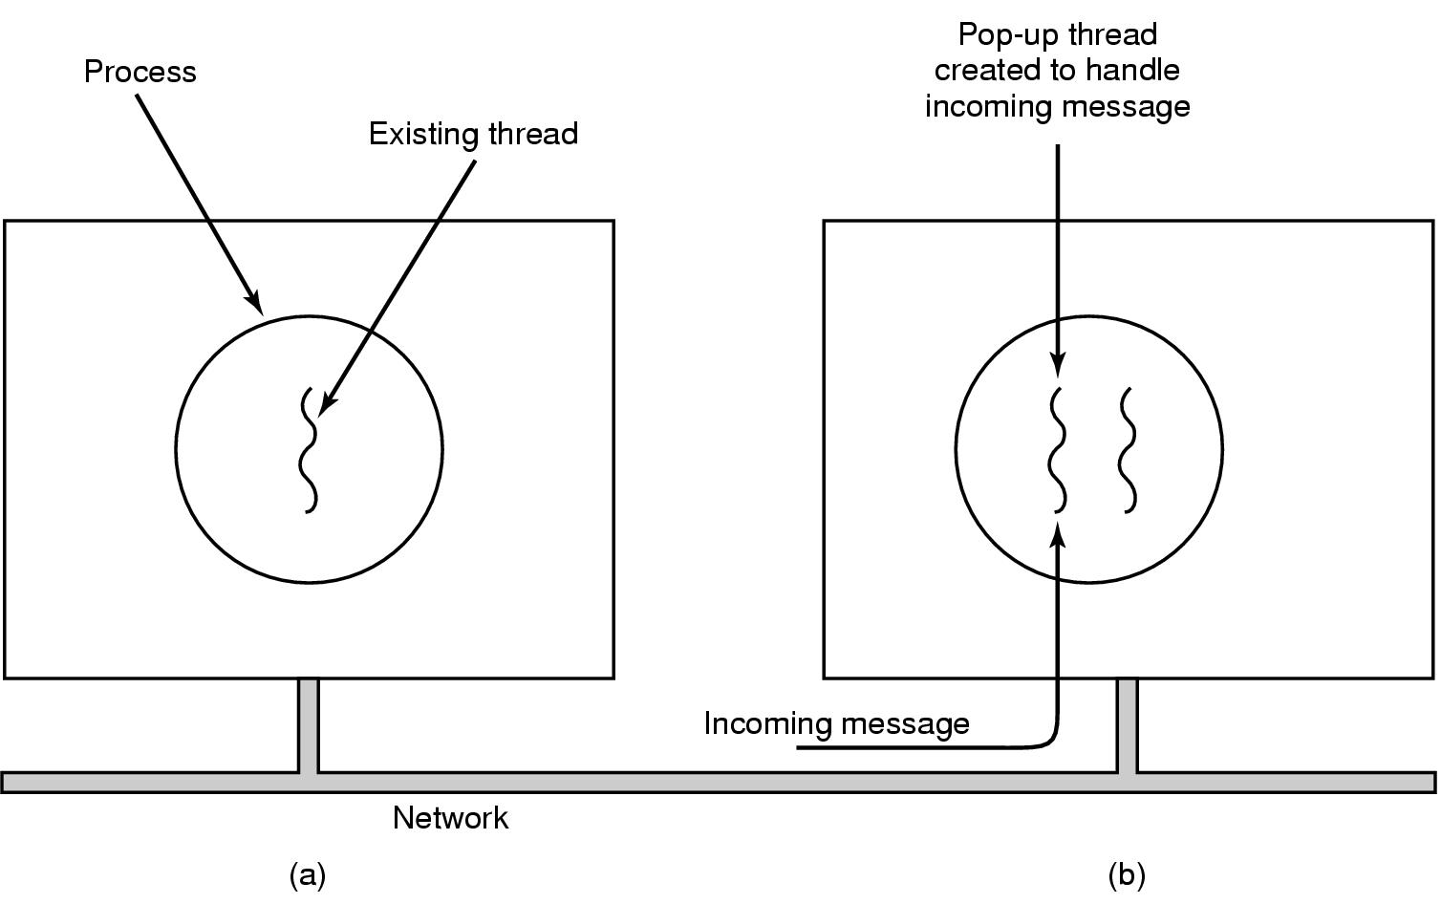
Pop-Up Threads
Incoming message handle: the traditional approach is to have a processor or thread that is blocked on a receive system call waiting for an incoming message.
Creation of a new thread when message arrives
  (a) before message arrives (b) after message arrives
Advantage: The pop-up threads are new, they do not have any history (registers, stack, etc) to be restored.

Slide 41
Processes and Threads
  2.1 Processes （进程）
  2.2 Threads（线程）
  2.3 Scheduling（调度）
  2.4 Interprocess communication（进程间通信）
  2.5 Classical IPC problems （经典ipc问题）

Slide 42
Introduction to Scheduling
Multiple processes competing for the CPU at the same time.
Scheduler: a choice has to be made which process to run next.
Many of the same issues that apply to process scheduling also apply to thread scheduling, although some are different.

Slide 43

Introduction to Scheduling
Bursts of CPU usage alternate with periods of I/O wait
  a CPU-bound process CPU密集型进程
  an I/O bound process (trend) I/O密集型进程

Slide 44
When to schedule
A new process is created.
A process exits.
A process block an I/O, on a semaphone, or for some other relation, another process has to be selected to run.
An I/O interrupt occurs.

Slide 45
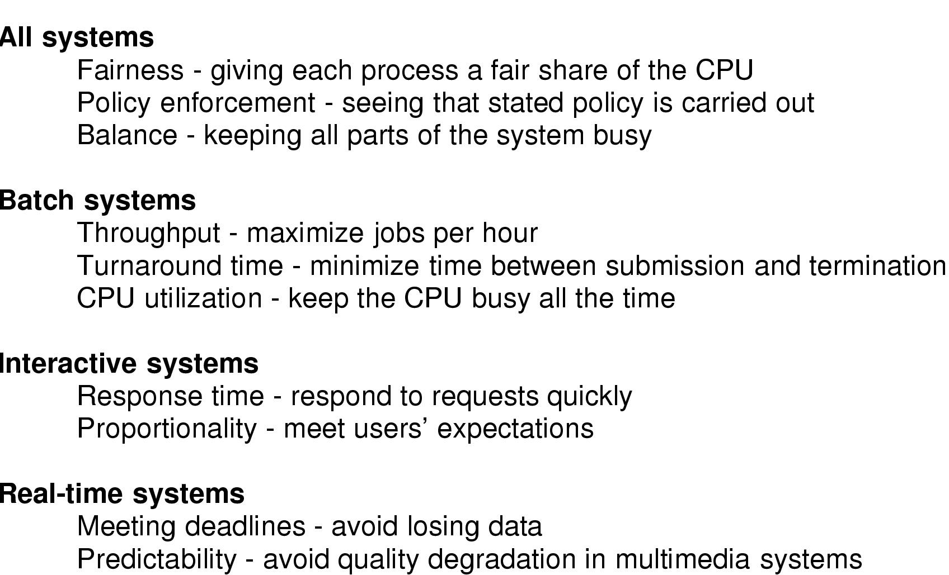
Scheduling Algorithm Goals
策略强制执行
周转时间
均衡性
可预测性

Slide 46
Scheduling in Batch Systems
First-come first-served (FCFS) scheduling
Advantage: It is easy to understand and equally easy to program.
Disadvantage: Poor CPU utilization.

Slide 47
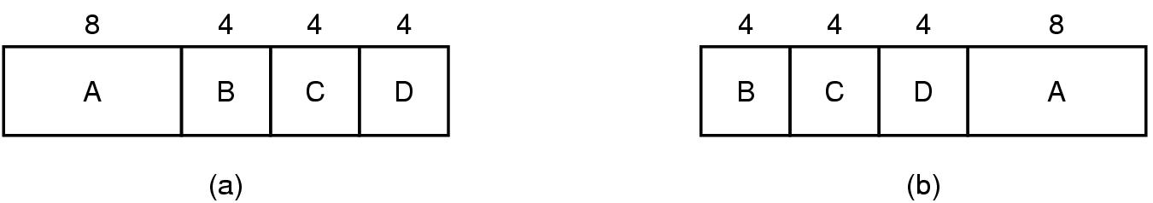
Scheduling in Batch Systems (2)
An example of shortest job first scheduling
a Turnaround time: A(8), B(12), C(16), D(20) Ave: 14s
b Turnaround time: A(20), B(4), C(8), D(12) Ave: 11s
Also, there is shortest remaining time next scheduling.

Slide 48
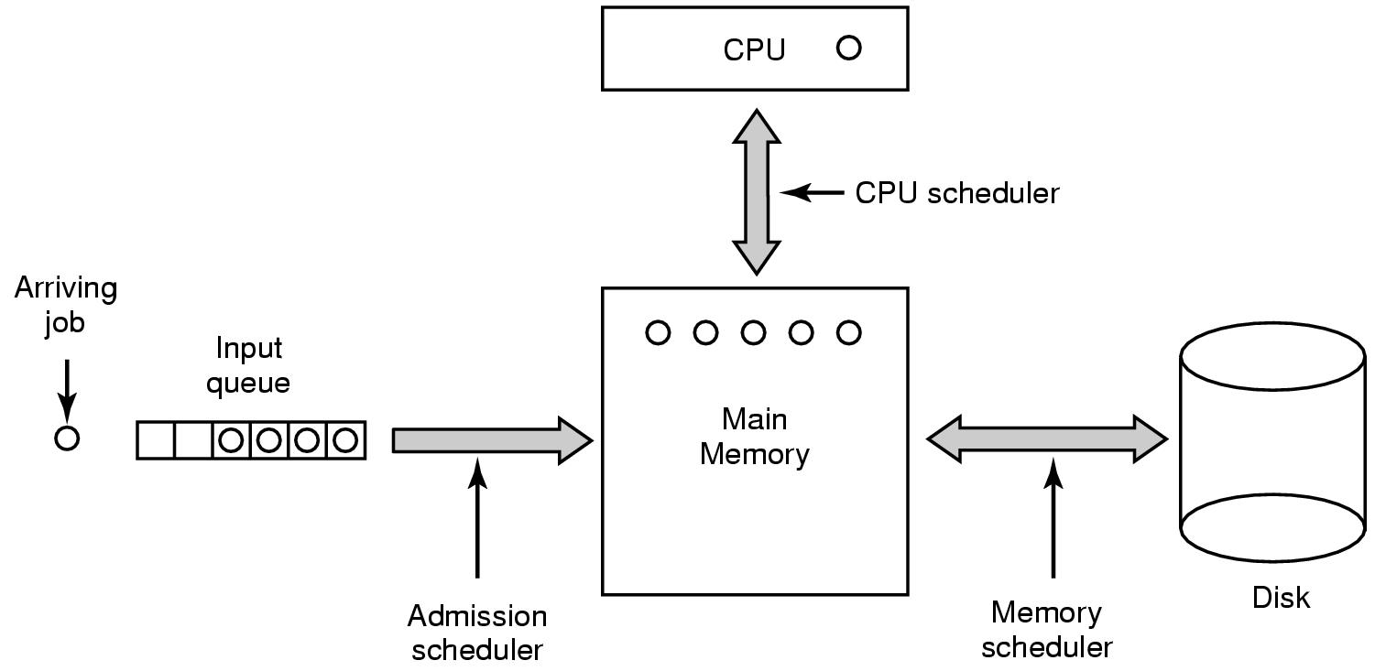
Scheduling in Batch Systems (3)
Three level scheduling

Slide 49
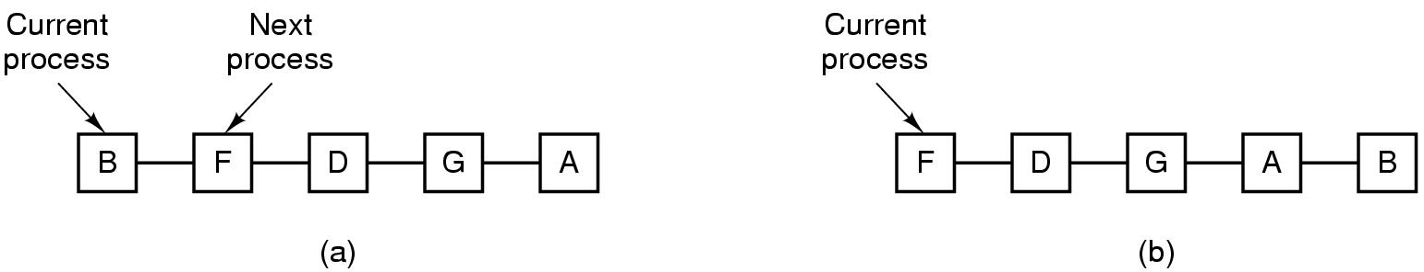
Scheduling in Interactive Systems
list of runnable processes
list of runnable processes after B uses up its quantum
Round Robin Scheduling
  Each process is assigned a time interval, called its quantum.
  The only interesting issue with round robin is the length of the quantum.
  Switching from one process to another requires a certain amount of time for doing the administration.
  Another factor is that if the quantum is set longer than the mean CPU burst, preemption will rarely happen.

Slide 50
Scheduling in Interactive Systems (2)
Priority scheduling
  Each process is assigned a priority, and the runnable process with the highest priority is allowed to run.
  Priority can be assigned to process statically or dynamically.

Slide 51
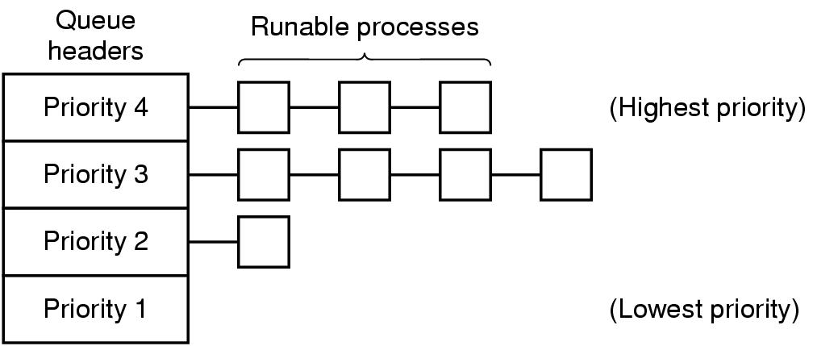
Scheduling in Interactive Systems (3)
A scheduling algorithm with four priority classes

Slide 52
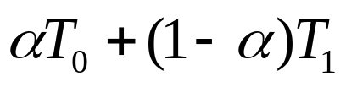


Scheduling in Interactive Systems (4)
Shortest process next
  Shortest job first always produces the minimum average response time.
  The problem is figuring out which of the currently runnable processes is the shortest one.
  One approach is to make estimates based on past behavior and run the process with the shortest estimated running time.
  With , we get succesive estimate of

Slide 53
Scheduling in Interactive Systems (5)
Multiple queues
Guaranteed scheduling
Lottery scheduling
  Give processes lottery tickets for various system resources, such as CPU time. Whenever a scheduling decision has to be made, a lottery ticket is chosen at random, and the process holding that ticket gets the resource.
Fair-share scheduling
  Take into account who owns a process before scheduling it.

Slide 54
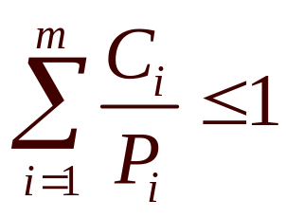
Scheduling in Real-Time Systems
Given
  m periodic events 周期事件
  event i occurs within period P_{i} and requires C_{i} seconds of CPU time to handle each event
Then the load can only be handled if
A real time system that meets this criteria is said to be schedulable (可调度的).
e.g. Three periodic events, with periods of 100, 200 and 500 msec, respectively. If these events require 50, 30, and 100 msec of CPU time per event. The system is schedulable because 0.5+0.15+0.2<1.

Slide 55
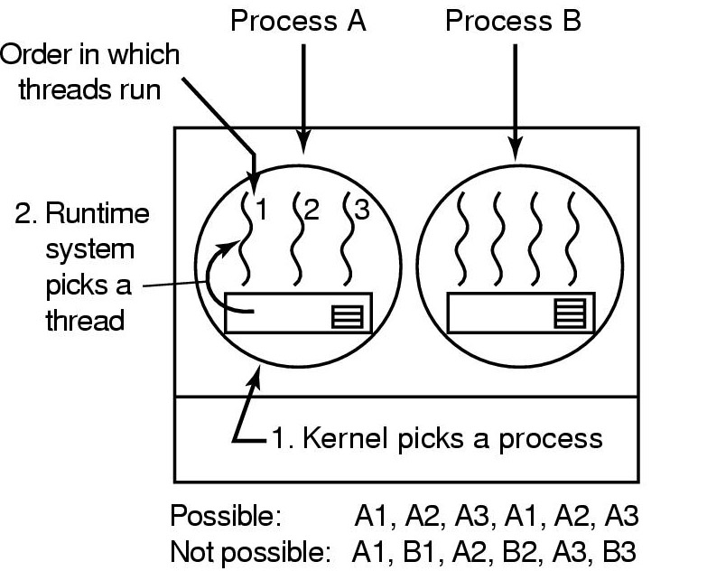
Thread Scheduling
Possible scheduling of user-level threads
50-msec process quantum
threads run 5 msec/CPU burst

Slide 56
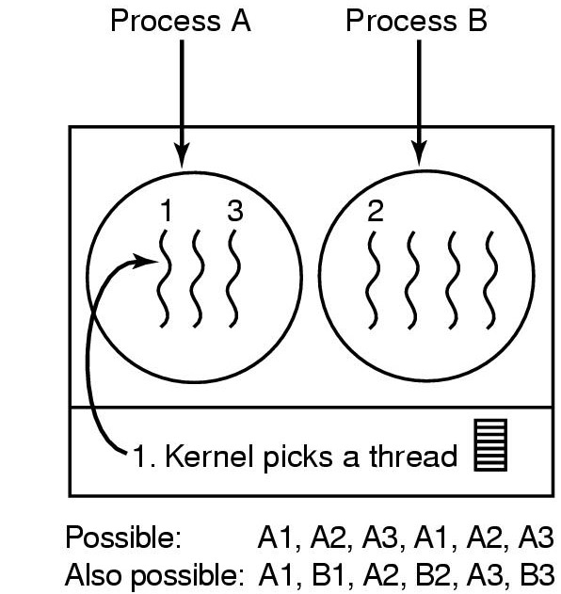
Thread Scheduling (2)
Possible scheduling of kernel-level threads
50-msec process quantum
threads run 5 msec/CPU burst

Slide 57
Operating Systems
Lesson 3 (refine and exercise)

Slide 58
CPU Scheduler
Selects from among the processes in memory that are ready to execute, and allocates the CPU to one of them.
CPU scheduling decisions may take place when a process:
1. Switches from running to waiting state.
2. Switches from running to ready state.
3. Switches from waiting to ready.
4. Terminates.
Scheduling under 1 and 4 is nonpreemptive （非抢占式调度）.
All other scheduling is preemptive （抢占式调度）.
Notes:
CPU调度程序

Slide 59
Dispatcher
Dispatcher module gives control of the CPU to the process selected by the short-term scheduler; this involves（进程调度模块负责将对CPU的控制权转交给由CPU调度程序，包括）:
  switching context（切换上下文）
  switching to user mode（切换到用户态）
  jumping to the proper location in the user program to restart that program（跳转到用户程序的适当位置并重新运行之）
Dispatch latency – time it takes for the dispatcher to stop one process and start another running（调度时间）.
Notes:
调度程序

Slide 60
Scheduling Criteria
CPU utilization – keep the CPU as busy as possible (Max)
Throughput – the number of processes that complete their execution per time unit (Max)
Turnaround time – the interval from submission to completion (Min)
Waiting time – amount of time a process has been waiting in the ready queue (Min)
Response time – amount of time it takes from when a request was submitted until the first response is produced, not output (for time-sharing environment) (Min)
Notes:
衡量调度的标准

Slide 61
First-Come, First-Served (FCFS) Scheduling
Example: Process Burst Time
P₁ 24
P₂ 3
P₃ 3
Suppose that the processes arrive in the order: P₁ , P₂ , P₃
The Gantt Chart（甘特图）for the schedule is:
Turnaround time for P₁ = 24; P₂ = 27; P₃ = 30
Average turnaround time: (24 + 27 + 30)/3 = 27
P₁
P₂
P₃
0
24
27
30
Notes:
先来先服务调度

Slide 62
FCFS Scheduling (Cont.)
Suppose that the processes arrive in the order: P₂ , P₃ , P₁ .
The Gantt chart for the schedule is :
Turnaround time for P₁ = 30; P₂ = 3; P₃ = 6
Average turnaround time : (30 + 3 + 6)/3 = 13
Much better than previous case.
Convoy effect 护送效应 short process behind long process
（此种结果产生是由于长进程先于短进程到达）
P₂
P₃
P₁
0
3
6
30
Notes:
先来先服务调度（续）

Slide 63
Shortest-Job-First (SJF) Scheduling
Associate with each process the length of its next CPU burst. Use these lengths to schedule the process with the shortest time.
Two schemes:
  nonpreemptive – once CPU given to the process it cannot be preempted until completes its CPU burst（非抢占式调度).
  Preemptive – if a new process arrives with CPU burst length less than remaining time of current executing process, preempt. This scheme is know as the Shortest-Remaining-Time-First (SRTF).（抢占式调度 –也称为最短剩余时间优先调度）
SJF is optimal – gives minimum average waiting time for a given set of processes.
Notes:
最短作业优先调度

Slide 64
Example of Non-Preemptive SJF
Process Arrival Time Burst Time
P₁ 0.0 7
P₂ 2.0 4
P₃ 4.0 1
P₄ 5.0 4
SJF (non-preemptive)
Average turnaround time = (7 + 10 + 4 + 11)/4 = 8
P₁
P₃
P₂
P₄
0
3
7
8
12
16

Slide 65
Example of Preemptive SJF
Process Arrival Time Burst Time
P₁ 0.0 7
P₂ 2.0 4
P₃ 4.0 1
P₄ 5.0 4
SJF (preemptive)
Average turnaround time = (16 + 5 + 1 +6)/4 ＝ 7
P₁
P₂
P₃
P₂
P₄
P₁
0
2
4
5
7
11
16

Slide 66
Priority Scheduling
A priority number (integer) is associated with each process.
The CPU is allocated to the process with the highest priority.
  Preemptive
  Nonpreemptive
SJF is a priority scheduling where priority is the predicted next CPU burst time.
Problem: Starvation – low priority processes may never execute.
Solution: Aging – as time progresses increase the priority of the process.
Notes:
优先级调度

Slide 67
Round Robin (RR)
Each process gets a small unit of CPU time (time quantum), usually 10-100 milliseconds. After this time has elapsed, the process is preempted and added to the end of the ready queue.
Performance
  q large ⇒ FIFO
  q small ⇒ q must be large with respect to context switch, otherwise overhead is too high.
Notes:
时间片轮转

Slide 68
Example: RR with Time Quantum = 20
Process Burst Time
P₁ 53
P₂ 17
P₃ 68
P₄ 24
The Gantt chart is:
Typically, higher average turnaround than SJF, but better response.
P₁
P₂
P₃
P₄
P₁
P₃
P₄
P₁
P₃
P₃
0
20
37
57
77
97
117
121
134
154
162

Slide 69

How a Smaller Time Quantum Increases Context Switches

Slide 70

Turnaround Time Varies With The Time Quantum

Slide 71
Multilevel Queue
Ready queue is partitioned into separate queues:
foreground (interactive)
background (batch)
Each queue has its own scheduling algorithm foreground – RR
background – FCFS
Scheduling must be done between the queues.
  Fixed priority scheduling; i.e., serve all from foreground then from background. Possibility of starvation.
  Time slice – each queue gets a certain amount of CPU time which it can schedule amongst its processes; e.g.,80% to foreground in RR
  20% to background in FCFS
Notes:
多级队列

Slide 72

Multilevel Queue Scheduling
Five priority in OS/MFT System

Slide 73
Multilevel Feedback Queue
Used in UNIX and OS/2
A process can move between the various queues; aging can be implemented this way.
Multilevel-feedback-queue scheduler defined by the following parameters:
  number of queues
  scheduling algorithms for each queue
  method used to determine when to upgrade（升级） a process
  method used to determine when to demote （降级）a process
  method used to determine which queue a process will enter when that process needs service
Notes:
多级反馈队列调度

Slide 74

Example of Multilevel Feedback Queue
Three queues:
  Q₀ – time quantum 8 milliseconds
  Q₁ – time quantum 16 milliseconds
  Q₂ – FCFS
Scheduling
  A new job enters queue Q₀ which is served FCFS. When it gains CPU, job receives 8 milliseconds. If it does not finish in 8 milliseconds, job is moved to queue Q₁ .
  At Q₁ job is again served FCFS and receives 16 additional milliseconds. If it still does not complete, it is preempted and moved to queue Q₂.
Notes:
多级反馈队列实例

Slide 75
Traditional UNIX Scheduling
Multilevel feedback using round robin within each of the priority queues
Priorities are recomputed once per second
Base priority divides all processes into fixed bands of priority levels
Adjustment factor used to keep process in its assigned band
The priority is based on the process type and executing history
cpu[j](i)= cpu[j](i-1)/2
p[j](i)=Base[j]＋ cpu[j](i)/2＋nice[j]

Slide 76
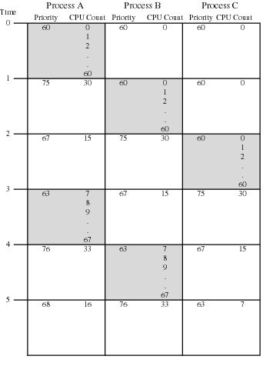
Fig. Example of Traditional UNIX Process Scheduling (Shaded rectangle represents executing process)

Slide 77
Exercise
Four batch jobs A through D, arrive at a computer center at 0, 2, 3, 4 second. They have estimated running time of 3, 5, 4, and 1 seconds. Their priorities are 3, 2, 1, and 4, respectively, with 1 being the highest priority. For each of the following scheduling algorithms, determine the mean process turnaround time. Ignore process switching overhead.
(a) Round robin (quantum=1s).
(b) Priority scheduling (Preemptive).
(c) Priority scheduling (Nonpreemptive).
(d) FCFS.
(e) Shortest job first (Preemptive).
(f) Shortest job first (Nonpreemptive).
Jobs | Arrive time | Running time | Priority
A | 0 | 3 | 3
B | 2 | 5 | 2
C | 3 | 4 | 1
D | 4 | 1 | 4

Slide 78
Homework
No.45, No.49

